Slide 1

BANK LOAN REPORT | SUMMARY
Power BI Desktop
 | Summary
 | Overview
 | Details
STATE All V GRADE All V PURPOSE All V
Total Loan Applications
38.6K
MTD MoM
4.3K 6.9%
Total Funded Amount
$435.8M
MTD MoM
$54M 13.0%
Total Received Amount
$473.1M
MTD MoM
$58.1M 15.8%
Average Interest Rate
12.0%
MTD MoM
12.4% 3.5%
Average DTI
13.3%
MTD MoM
13.7% 2.7%
GOOD LOAN ISSUED
Good Loan Applications
33K
Good Loan Funded Amount
$370.2M
Good Loan Received Amount
$435.8M
GOOD LOAN ISSUED
Bad Loan Applications
5.3K
Bad Loan Funded Amount
$65.5M
Bad Loan Received Amount
$37.3M
LOAN STATUS
Loan Status | Total Loan Applications | Total Funded Amount | Total Amount Recieved V | MTD Total Loan Amount | MTD Total Amount Received | Avg Interest rate | Avg DTI
Fully Paid | 32145 | $35,13,58,350 | $41,15,86,256 | $4,13,02,025 | $4,78,15,851 | 11.64% | 13.17%
Charged Off | 5333 | $6,55,32,225 | $3,72,84,763 | $87,32,775 | $53,24,211 | 13.88% | 14.00%
Current | 1098 | $1,88,66,500 | $2,41,99,914 | $39,46,625 | $49,34,318 | 15.10% | 14.72%
Grand Total | 38576 | $43,57,57,075 | $47,30,70,933 | $5,39,81,425 | $5,80,74,380 | 12.05% | 13.33%

Slide 2
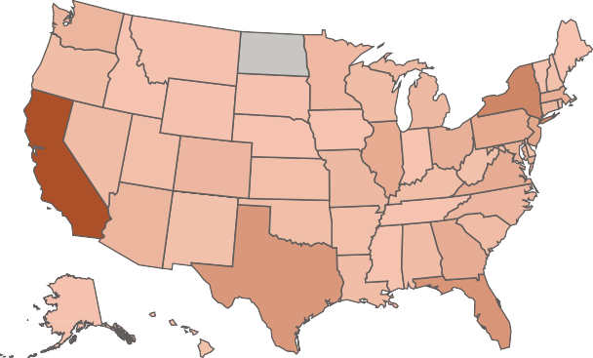
BANK LOAN REPORT | SUMMARY
Power BI Desktop
Total Loan Applications
38.6K
MTD MoM
4.3K 6.9%
Total Funded Amount
$435.8M
MTD MoM
$54M 13.0%
Total Received Amount
$473.1M
MTD MoM
$58.1M 15.8%
Average Interest Rate
12.0%
MTD MoM
12.4% 3.5%
Average DTI
13.3%
MTD MoM
13.7% 2.7%
Summary
Total Loan Applications by Month
Total Loan Applications by State
Total Loan Applications by Term
36 months 60 months
10K (26.8%)
Overview
4.0K
3.8K
4.3K
_{3.4K 3.4K} 3.5K
3.2K
Details
2.9K
_{2.6K} 2.8K
Select Measure
2.3K _{2.3K}
Total Loan Ap… V
28K
(73.2%)
Jan Feb Mar Apr May Jun
Jul Aug Sep Oct Nov Dec
State
Total Loan Applications by Employee Length
Total Loan Applications by Purpose
Total Loan Applications by Home Ownership
All V
10+ years
< 1 year
2 years
3 years
4 years
5 years
1 year
6 years
7 years
8 years
8.9K
Debt consoli… credit card
other home impro… major purch… small business
car wedding medical moving
18K
4.6K
4.4K
5K
RENT
Grade
4K
3K
All V
4.1K
3.4K
3.3K
3.2K
2K
2K
1K
18K
Good vs Bad Loan
MORTGAGE
All V
2.2K
1K
1K
1K
1.8K
1.5K
17K

Slide 3
BANK LOAN REPORT | DETAILS
Power BI Desktop
Total Loan Applications
38.6K
MTD MoM
4.3K 6.9%
Total Funded Amount
$435.8M
MTD MoM
$54M 13.0%
Total Received Amount
$473.1M
MTD MoM
$58.1M 15.8%
Average Interest Rate
12.0%
MTD MoM
12.4% 3.5%
Average DTI
13.3%
MTD MoM
13.7% 2.7%
 | Summary
 | Overview
 | Details
ID Purpose Home Ownership Grade Sub Grade Issue Date Total Funded Amount Interest Rate Installment
Total Amount Reci
54734 | Debt consolidation | RENT | B | B4 | 09 August 2021 | $25,000 | 0.12 | 829.10 | $2
55742 | credit card | RENT | B | B5 | 08 May 2021 | $7,000 | 0.11 | 228.22 | $
57245 | Debt consolidation | OWN | C | C2 | 10 March 2021 | $1,200 | 0.13 | 40.50 | $
57416 | Debt consolidation | RENT | C | C3 | 09 November 2021 | $10,800 | 0.14 | 366.86 | $1
58915 | Debt consolidation | RENT | B | B3 | 08 April 2021 | $7,500 | 0.10 | 162.34 | $
59006 | credit card | MORTGAGE | C | C5 | 09 September 2021 | $3,000 | 0.14 | 102.92 | $
61390 | credit card | MORTGAGE | A | A5 | 10 February 2021 | $4,000 | 0.08 | 125.13 | $
61419 | Debt consolidation | RENT | D | D2 | 10 February 2021 | $5,600 | 0.15 | 194.02 | $
62102 | Debt consolidation | RENT | B | B1 | 10 April 2021 | $3,200 | 0.10 | 103.08 | $
65426 | car | MORTGAGE | B | B1 | 09 August 2021 | $4,000 | 0.11 | 131.22 | $
65640 | home improvement | MORTGAGE | C | C2 | 08 May 2021 | $5,000 | 0.11 | 87.19 | $
66431 | Debt consolidation | RENT | B | B5 | 09 February 2021 | $2,525 | 0.12 | 84.12 | $
66749 | Debt consolidation | MORTGAGE | C | C4 | 08 December 2021 | $10,625 | 0.13 | 360.43 | $1
66943 | Debt consolidation | RENT | B | B4 | 10 August 2021 | $2,800 | 0.11 | 61.57 | $
66964 | Debt consolidation | MORTGAGE | D | D3 | 08 June 2021 | $7,500 | 0.13 | 253.58 | $
67503 | Debt consolidation | MORTGAGE | A | A4 | 09 October 2021 | $10,000 | 0.09 | 316.11 | $1
68163 | small business | MORTGAGE | A | A3 | 10 February 2021 | $3,000 | 0.07 | 92.82 | $
Select Measure
Total Loan Ap… V
State
All V
Grade
All V
Good vs Bad Loan
All V

